Slide 1
Lecture 4
The LU Decomposition

Slide 2
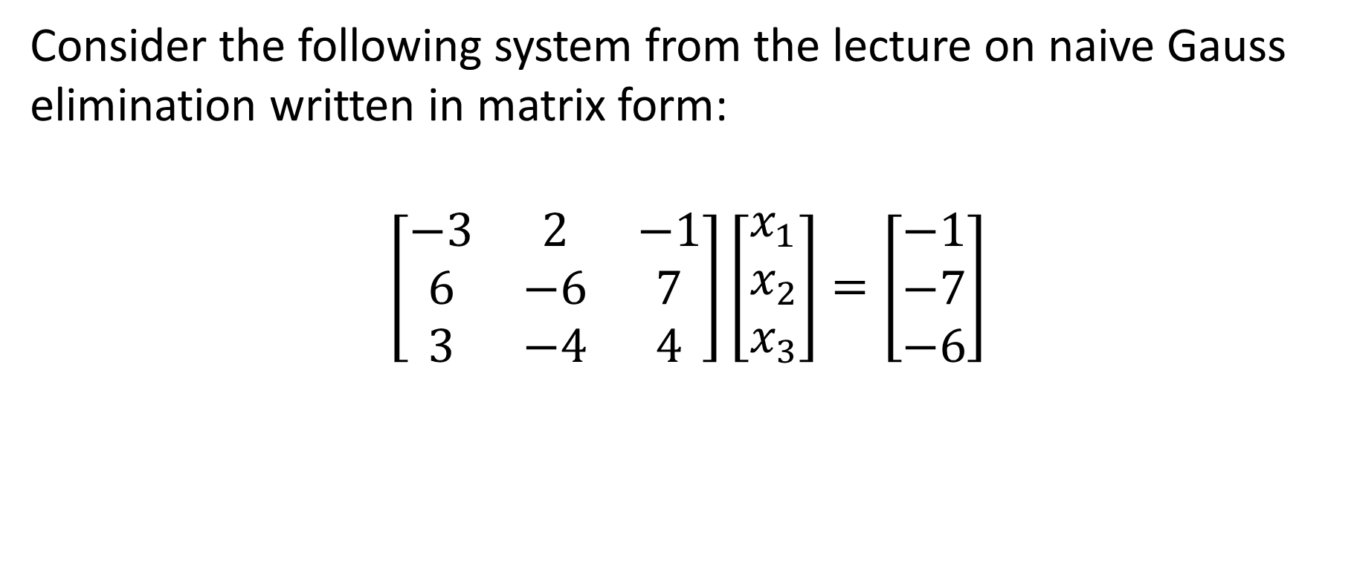
Introduction
Consider the following system from the lecture on naive Gauss elimination written in matrix form:
$$\left[\begin{matrix}−3 & 2 & −1 \\ 6 & −6 & 7 \\ 3 & −4 & 4\end{matrix}\right]\left[\begin{matrix}x_{1} \\ x_{2} \\ x_{3}\end{matrix}\right]=\left[\begin{matrix}−1 \\ −7 \\ −6\end{matrix}\right]$$
Notes:
Let us start with a system of linear equations we used in our pervious lecture on Gauss elimination

Slide 3
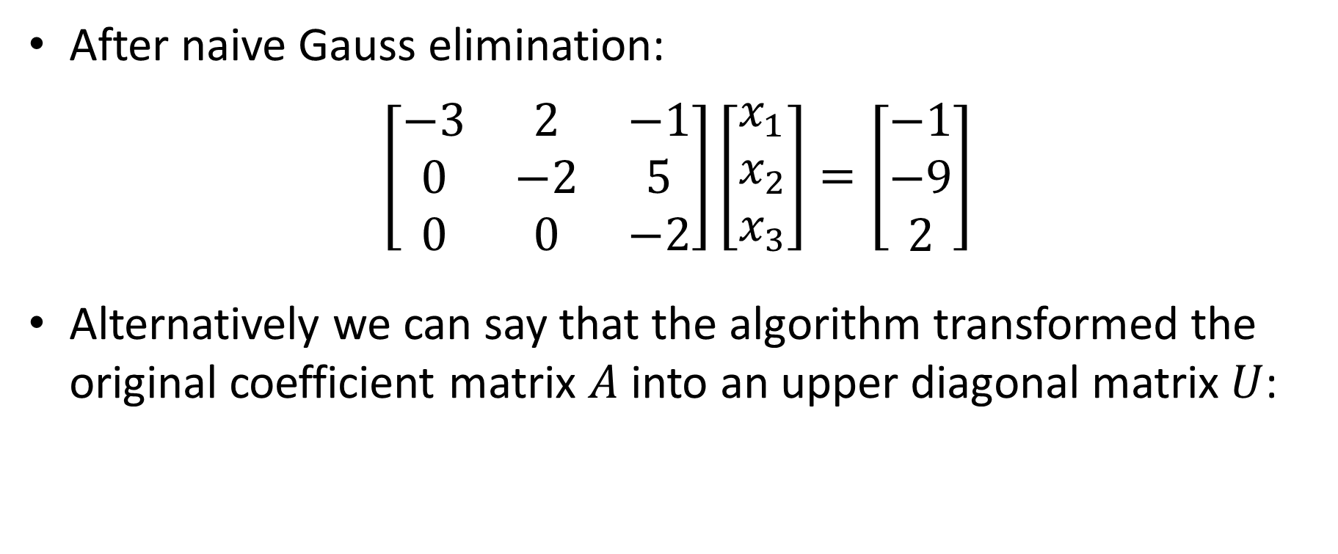


Introduction
After naive Gauss elimination:
$$\left[\begin{matrix}−3 & 2 & −1 \\ 0 & −2 & 5 \\ 0 & 0 & −2\end{matrix}\right]\left[\begin{matrix}x_{1} \\ x_{2} \\ x_{3}\end{matrix}\right]=\left[\begin{matrix}−1 \\ −9 \\ 2\end{matrix}\right]$$
Alternatively we can say that the algorithm transformed the original coefficient matrix $A$ into an upper diagonal matrix $U$:
$$A=\left[\begin{matrix}−3 & 2 & −1 \\ 6 & −6 & 7 \\ 3 & −4 & 4\end{matrix}\right]$$
$$U=\left[\begin{matrix}−3 & 2 & −1 \\ 0 & −2 & 5 \\ 0 & 0 & −2\end{matrix}\right]$$
Notes:
After completing the Gauss elimination algorithm we obtained the displayed upper diagonal system
Alternatively we can say that the algorithm transformed the original coefficient matrix $A$ into an upper diagonal matrix $U$

Slide 4
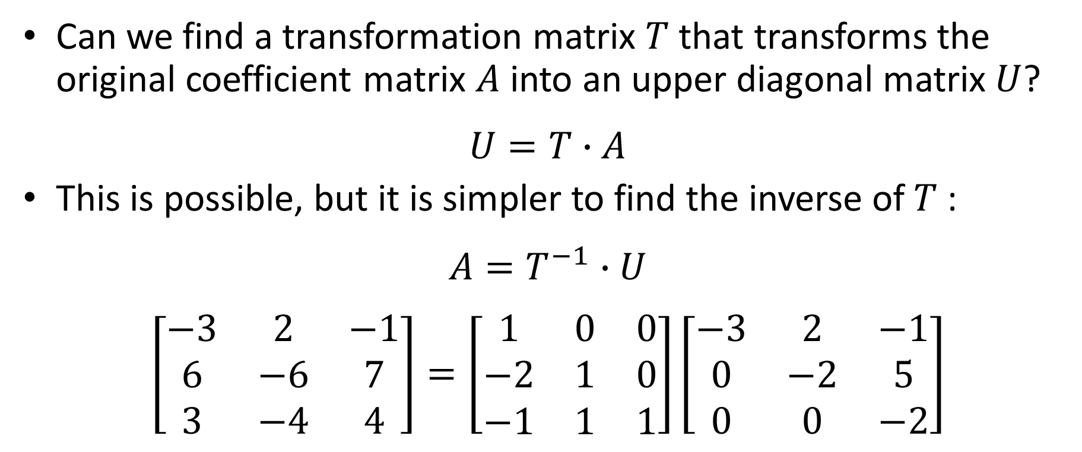



Introduction
Can we find a transformation matrix $T$ that transforms the original coefficient matrix $A$ into an upper diagonal matrix $U$?
$$U=T∙A$$
This is possible, but it is simpler to find the inverse of $T$:
$$A=T^{−1}∙U$$
$$\left[\begin{matrix}−3 & 2 & −1 \\ 6 & −6 & 7 \\ 3 & −4 & 4\end{matrix}\right]=\left[\begin{matrix}1 & 0 & 0 \\ −2 & 1 & 0 \\ −1 & 1 & 1\end{matrix}\right]\left[\begin{matrix}−3 & 2 & −1 \\ 0 & −2 & 5 \\ 0 & 0 & −2\end{matrix}\right]$$
Matrix $A$
Transformation matrix $T^{−1}$
Matrix $U$
Notes:
We may wonder if we can find a transformation matrix $T$ that transforms the original coefficient matrix $A$ into an upper diagonal matrix $U$ such that we have
U=TA
This is indeed possible, but it turns out that it simpler to find the inverse of this transformation matrix T
In our example that is how looks this transformation
How can we find this matrix T-1?

Slide 5










Introduction
Observe the transformation matrix $T^{−1}$ and compare with the naive Gauss elimination algorithm:
$$\left[\begin{matrix}−3 & 2 & −1 & | & −1 \\ 6 & −6 & 7 & | & −7 \\ 3 & −4 & 4 & | & −6\end{matrix}\right]$$
$$r_{2}←R_{2}−\left(−2\right)R_{1}$$
$$\left[\begin{matrix}−3 & 2 & −1 & | & −1 \\ 0 & −2 & 5 & | & −9 \\ 0 & −2 & 3 & | & −7\end{matrix}\right]$$
$$T^{−1}=\left[\begin{matrix}1 & 0 & 0 \\ −2 & 1 & 0 \\ −1 & 1 & 1\end{matrix}\right]$$
$$r_{3}←R_{3}−\left(−1\right)R_{1}$$
$$\left[\begin{matrix}−3 & 2 & −1 & | & −1 \\ 0 & −2 & 5 & | & −9 \\ 0 & −2 & 3 & | & −7\end{matrix}\right]$$
$$\left[\begin{matrix}−3 & 2 & −1 & | & −1 \\ 0 & −2 & 5 & | & −9 \\ 0 & 0 & −2 & | & 2\end{matrix}\right]$$
$$r_{3}←R_{3}−{\left(+1\right)R}_{2}$$
Transformation matrix $T^{−1}$
Naive Gauss elimination algorithm
Notes:
In fact it is straight forward to find this transformation matrix.
For this let us compare the matrix with our calculations we used during the Gauss elimination algorithm
Note how the two entries -2 and -1 form the matrix T-1 are the coefficient we used in the Gauss elimination algorithm
And the same observation holds for the entry 1.
The reminder of the transformation matrix will always be the same, regardless on which system of equation we consider

Slide 6
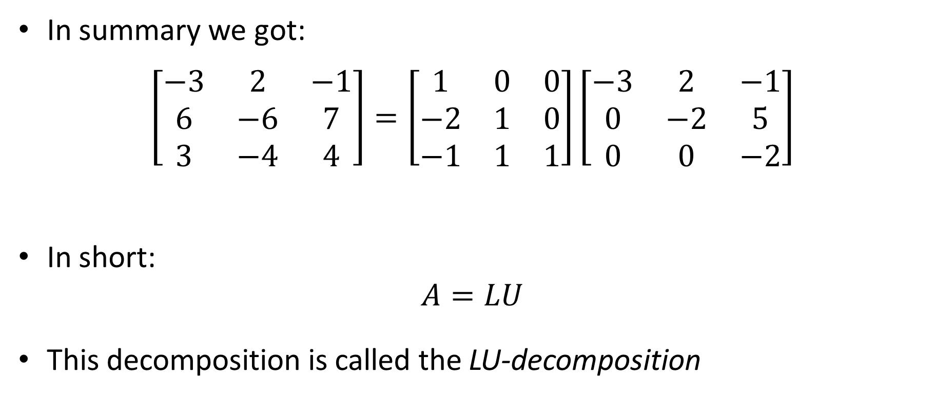



Introduction
In summary we got:
$$\left[\begin{matrix}−3 & 2 & −1 \\ 6 & −6 & 7 \\ 3 & −4 & 4\end{matrix}\right]=\left[\begin{matrix}1 & 0 & 0 \\ −2 & 1 & 0 \\ −1 & 1 & 1\end{matrix}\right]\left[\begin{matrix}−3 & 2 & −1 \\ 0 & −2 & 5 \\ 0 & 0 & −2\end{matrix}\right]$$
In short:
$$A=LU$$
This decomposition is called the LU-decomposition
Matrix $A$
Lower diagonal matrix $L$
Upper diagonal matrix $U$
Notes:
Let us summarize our example
We observe that the original coefficient matrix A is the product of two matrices. One being a lower diagonal matrix and the second being an upper diagonal matrix
On writes in short A=LU
This decomposition of the matrix A into the product L times U is called the LU decomposition.

Slide 7
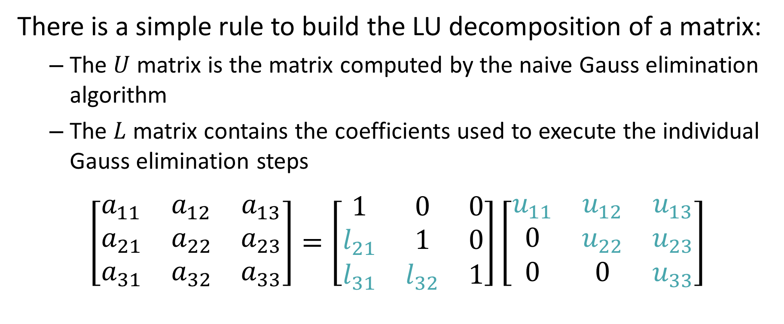


LU Decomposition
There is a simple rule to build the LU decomposition of a matrix:
The $U$ matrix is the matrix computed by the naive Gauss elimination algorithm
The $L$ matrix contains the coefficients used to execute the individual Gauss elimination steps
$$\left[\begin{matrix}a_{11} & a_{12} & a_{13} \\ a_{21} & a_{22} & a_{23} \\ a_{31} & a_{32} & a_{33}\end{matrix}\right]=\left[\begin{matrix}1 & 0 & 0 \\ l_{21} & 1 & 0 \\ l_{31} & l_{32} & 1\end{matrix}\right]\left[\begin{matrix}u_{11} & u_{12} & u_{13} \\ 0 & u_{22} & u_{23} \\ 0 & 0 & u_{33}\end{matrix}\right]$$
Matrix $A$
Lower diagonal matrix $L$
Upper diagonal matrix $U$
Notes:
There is a very simple rule to build the LU decomposition of a matrix.
First, the $U$ matrix is the matrix computed by the naive Gauss elimination algorithm
Second, the $L$ matrix is obtained by filling the coefficients used to execute the individual Gauss elimination steps into the right places.
An important note is that not all matrices A can be decomposed into such a product.
If the naive Gauss elimination step can not be performed on a system $A\underline{x}=\underline{b}$, then there is no LU decomposition of $A$

Slide 8



Example
$$r_{2}←R_{2}−3R_{1}$$
Gauss elimination for column 1
$$r_{3}←R_{3}−\left(−2\right)R_{1}$$
Gauss elimination for column 2
$$r_{3}←R_{3}−(−2)R_{2}$$
Notes:
Let us use this rule on an example
There are several ways how the calculations can be presented. We explain you here one possible way to organize your calculations
We start by writing the identity A = Unity matrix times A
As the calculations will proceed, we will progressively transform the identity matrix into the L matrix and the A matrix into the U matrix.
This transformation takes place using the Gauss elimination algorithm
For our example we identify the row operations to proceed with the Gauss elimination on the first column of the A matrix.
First operation is to remove three times the first row from the second one
And the second operation is to remove (-2) times the first row from the third one
It is very important to keep these row operations exactly the way we introduced them in the Gauss elimination step. Otherwise you will get the wrong signs in the L matrix.
Having identified the row operation you allow us to determine the modified unity and A matrix.
For the modified unity matrix you need to copy the coefficients you used in the Gauss elimination: 3 and -2 in our example
For the modified A matrix you copy the block computed in the Gauss elimination step done with the two identified row operations.
At this stage you may want to check that the identity still holds:
A must be equal to the modified unity matrix times the modified A matrix.
This is an important check in order to verify that you identified properly the coefficients in the modified unity matrix, and didn’t accidently take their opposite signs.
To take the wrong sign is a common mistake.
Once done the check and being confident all is correct, we can now proceed with the Gauss elimination on the second column.
The row operation to apply in order to eliminate the second unknown is to remove (-2) times the second row from the third one.
Having identified this row operation allows us to complete the LU decomposition
Therefore we copy the coefficient (-2) into the L matrix at the right position.
For the U matrix we copy the obtained result from this row operation
If everything went well, we got the desired decomposition.
We can check our result by doing the product L times U and verify we indeed get A.

Slide 9
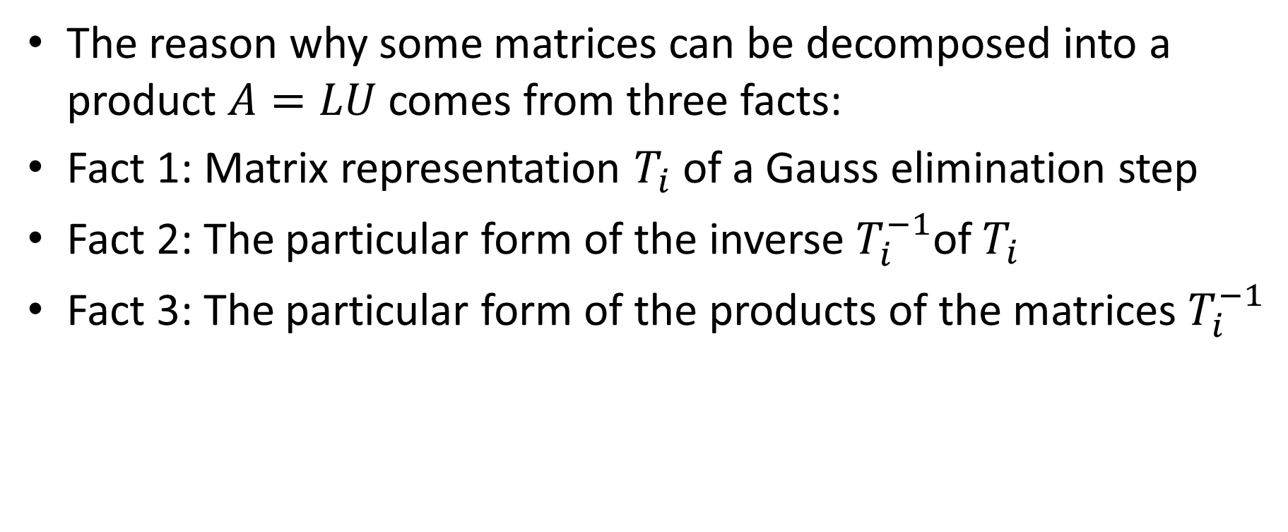
LU Decomposition
The reason why some matrices can be decomposed into a product $A=LU$ comes from three facts:
Fact 1: Matrix representation $T_{i}$ of a Gauss elimination step
Fact 2: The particular form of the inverse $T_{i}^{−1}$of $T_{i}$
Fact 3: The particular form of the products of the matrices $T_{i}^{−1}$
Notes:
At this stage you have learned how to find the LU decomposition of a matrix.
But why does this actually work?
The reason why some matrices can be decomposed into a product $A=LU$ comes from three facts:
Fact 1: Matrix representation $T_{i}$ of a Gauss elimination step
Fact 2: The particular form of the inverse $T_{i}^{−1}$of $T_{i}$
Fact 3: The particular form of the products of the matrices $T_{i}^{−1}$
Let us go over these three facts and discover how, by combining them, we can understand that a matrix A can indeed be decomposed into L times U

Slide 10
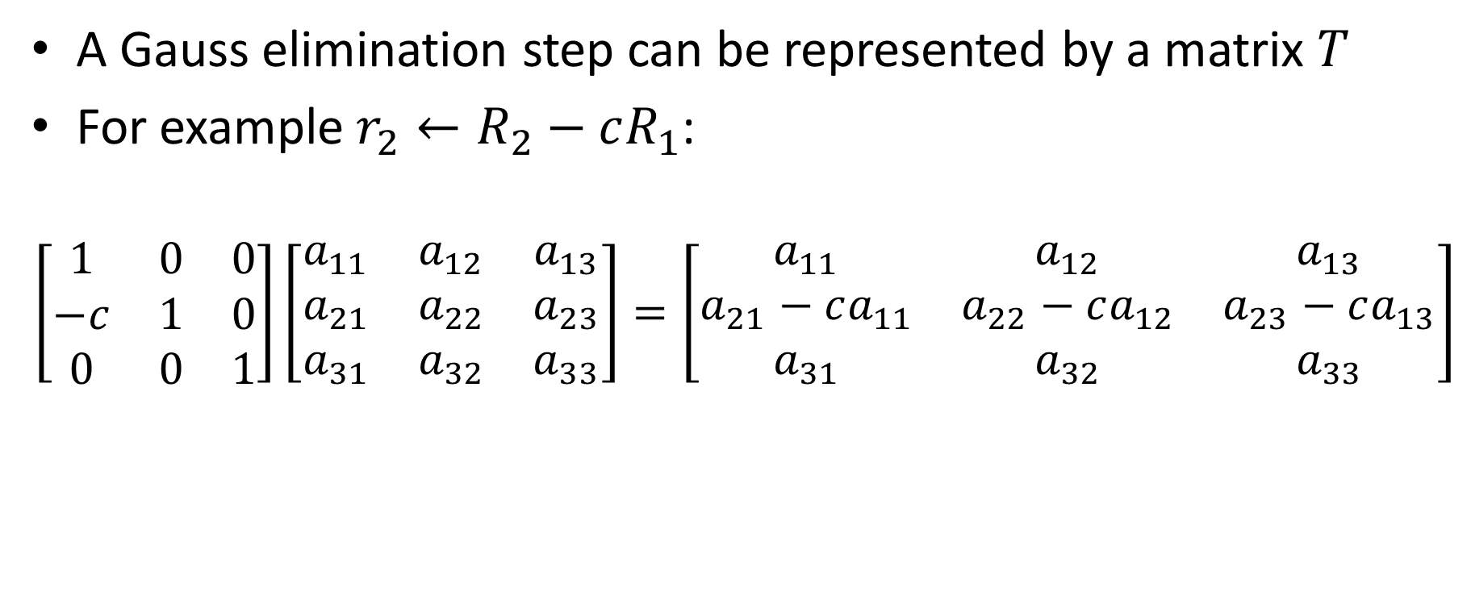



Fact 1
A Gauss elimination step can be represented by a matrix $T$
For example $r_{2}←R_{2}−cR_{1}$:
$$\left[\begin{matrix}1 & 0 & 0 \\ −c & 1 & 0 \\ 0 & 0 & 1\end{matrix}\right]\left[\begin{matrix}a_{11} & a_{12} & a_{13} \\ a_{21} & a_{22} & a_{23} \\ a_{31} & a_{32} & a_{33}\end{matrix}\right]=\left[\begin{matrix}a_{11} & a_{12} & a_{13} \\ a_{21}−ca_{11} & a_{22}−ca_{12} & a_{23}−ca_{13} \\ a_{31} & a_{32} & a_{33}\end{matrix}\right]$$
Matrix $T$
Matrix $A$
Matrix $A$ after Gauss elimination step
Notes:
The first fact we use is that a Gauss elimination step can be written with a matrix multiplication
For example the row operations: remove c times row one from row 2 can be written as a matrix product as displayed:
Note the position of the coefficient –c in the unity matrix

Slide 11













Application of fact 1
Applied to our introductory example:
$$\left[\begin{matrix}−3 & 2 & −1 & | & −1 \\ 6 & −6 & 7 & | & −7 \\ 3 & −4 & 4 & | & −6\end{matrix}\right]$$
$$r_{2}←R_{2}−\left(−2\right)R_{1}$$
$$\left[\begin{matrix}−3 & 2 & −1 & | & −1 \\ 0 & −2 & 5 & | & −9 \\ 0 & −2 & 3 & | & −7\end{matrix}\right]$$
$$r_{3}←R_{3}−\left(−1\right)R_{1}$$
$$\left[\begin{matrix}−3 & 2 & −1 & | & −1 \\ 0 & −2 & 5 & | & −9 \\ 0 & −2 & 3 & | & −7\end{matrix}\right]$$
$$\left[\begin{matrix}−3 & 2 & −1 & | & −1 \\ 0 & −2 & 5 & | & −9 \\ 0 & 0 & −2 & | & 2\end{matrix}\right]$$
$$r_{3}←R_{3}−{\left(+1\right)R}_{2}$$
$$T_{1}=\left[\begin{matrix}1 & 0 & 0 \\ 2 & 1 & 0 \\ 0 & 0 & 1\end{matrix}\right]$$
First step: $r_{2}←R_{2}−\left(−2\right)R_{1}$
$$T_{3}=\left[\begin{matrix}1 & 0 & 0 \\ 0 & 1 & 0 \\ 0 & −1 & 1\end{matrix}\right]$$
Third step $: r_{3}←R_{3}−{\left(+1\right)R}_{2}$
$$T_{2}=\left[\begin{matrix}1 & 0 & 0 \\ 0 & 1 & 0 \\ 1 & 0 & 1\end{matrix}\right]$$
Second step : $r_{3}←R_{3}−\left(−1\right)R_{1}$
Notes:
Let us apply this fact to an example
Displayed are the three row operations required to transform the given system of equations into an upper diagonal system.
Each of the three row operations can be written in matrix form.
The first row operation is associated to a matrix T1.
The row operation was to remove -2 times first row from second row.
The coefficient c is here +2, which is minus (-2)
In same way we proceed with the second row operation
Here we get a matrix T2
The coefficient c is here +1, which is minus (-1)
And finally considering the third row operation
We get a matrix T3.
The coefficient c is here -1, which is minus (+1)

Slide 12

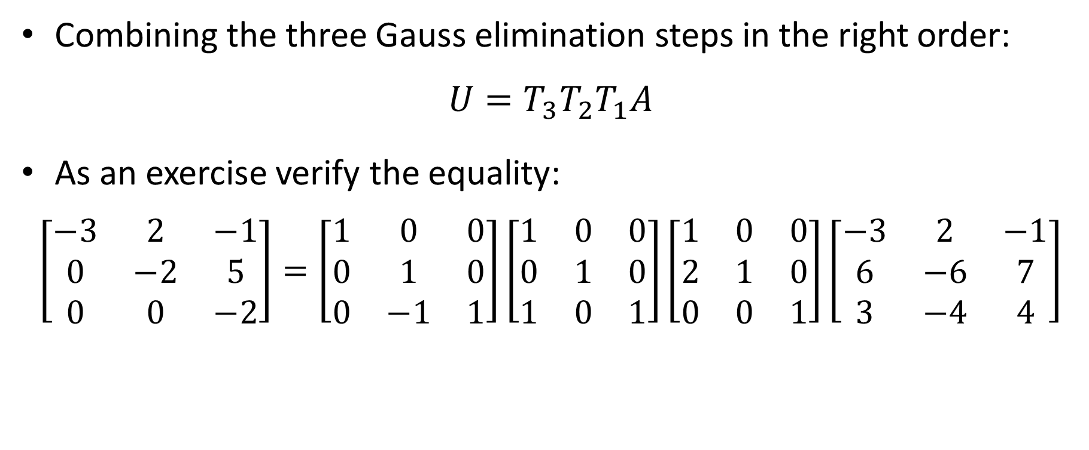




Combining the three Gauss elimination steps in the right order:
$$U={{T_{3}T}_{2}T}_{1}A$$
As an exercise verify the equality:
$$\left[\begin{matrix}−3 & 2 & −1 \\ 0 & −2 & 5 \\ 0 & 0 & −2\end{matrix}\right]=\left[\begin{matrix}1 & 0 & 0 \\ 0 & 1 & 0 \\ 0 & −1 & 1\end{matrix}\right]\left[\begin{matrix}1 & 0 & 0 \\ 0 & 1 & 0 \\ 1 & 0 & 1\end{matrix}\right]\left[\begin{matrix}1 & 0 & 0 \\ 2 & 1 & 0 \\ 0 & 0 & 1\end{matrix}\right]\left[\begin{matrix}−3 & 2 & −1 \\ 6 & −6 & 7 \\ 3 & −4 & 4\end{matrix}\right]$$
Matrix $U$
$$T_{3}$$
$$T_{2}$$
$$T_{1}$$
Matrix $A$
Notes:
To obtain the upper diagonal matrix U, we need to combine in the right order the three Gauss elimination step
That is we first apply T1 by computing T1 times A
The second step is applied by multiplying T2 by the previous result, which gives T2*T1*A
Adding the third step gives the desired U matrix: U = T3*T2*T1*A
As an exercise I recommend you to verify this fact by doing explicitly the matrix multiplications

Slide 13
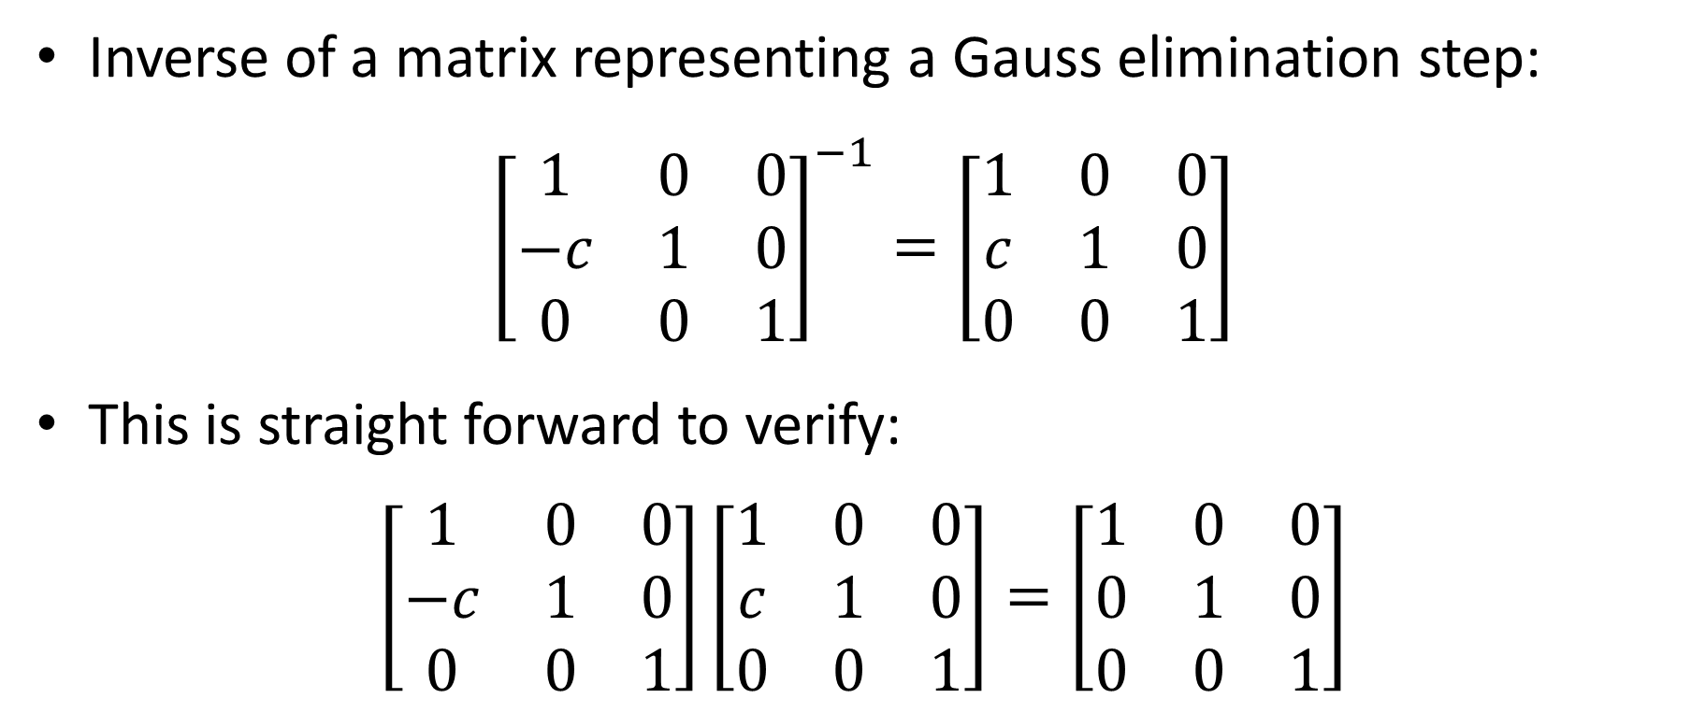
Fact 2
Inverse of a matrix representing a Gauss elimination step:
$${\left[\begin{matrix}1 & 0 & 0 \\ −c & 1 & 0 \\ 0 & 0 & 1\end{matrix}\right]}^{−1}=\left[\begin{matrix}1 & 0 & 0 \\ c & 1 & 0 \\ 0 & 0 & 1\end{matrix}\right]$$
This is straight forward to verify:
$$\left[\begin{matrix}1 & 0 & 0 \\ −c & 1 & 0 \\ 0 & 0 & 1\end{matrix}\right]\left[\begin{matrix}1 & 0 & 0 \\ c & 1 & 0 \\ 0 & 0 & 1\end{matrix}\right]=\left[\begin{matrix}1 & 0 & 0 \\ 0 & 1 & 0 \\ 0 & 0 & 1\end{matrix}\right]$$
Notes:
The second fact we need is that the inverse of a matrix T representing a Gauss elimination step is straight forward to find
One simply changes the sign of the coefficient c.
You can verify this by doing the multiplication of T-1 * T and verify that indeed you get the unity matrix.

Slide 14

Fact 3
The following equality holds
$$\left[\begin{matrix}1 & 0 & 0 \\ a & 1 & 0 \\ 0 & 0 & 1\end{matrix}\right]\left[\begin{matrix}1 & 0 & 0 \\ 0 & 1 & 0 \\ b & 0 & 1\end{matrix}\right]\left[\begin{matrix}1 & 0 & 0 \\ 0 & 1 & 0 \\ 0 & c & 1\end{matrix}\right]=\left[\begin{matrix}1 & 0 & 0 \\ a & 1 & 0 \\ b & c & 1\end{matrix}\right]$$
Notes:
The last fact is based on the displayed multiplication
The multiplication of the three Gauss elimination matrices T, results into a lower diagonal matrix.
I encourage you to verify this fact by doing explicitly the matrix product.

Slide 15
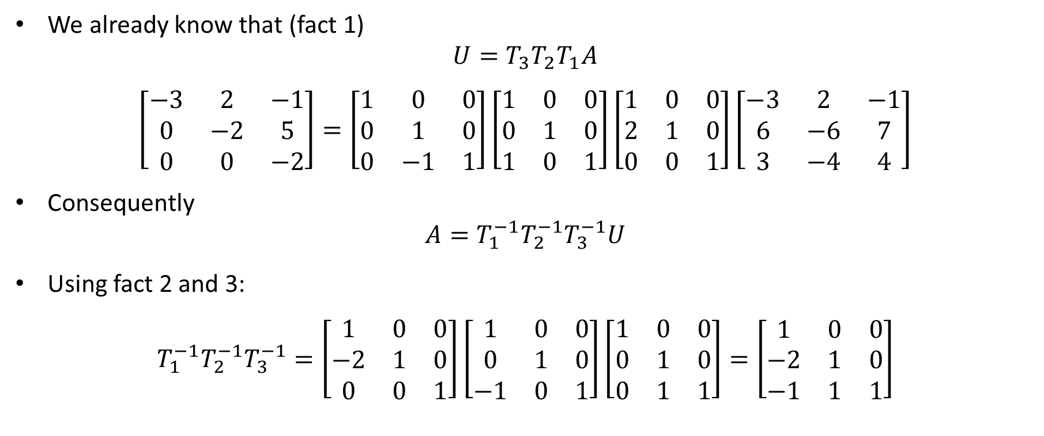
Combining all three facts
We already know that (fact 1)
$$U={{T_{3}T}_{2}T}_{1}A$$
$$\left[\begin{matrix}−3 & 2 & −1 \\ 0 & −2 & 5 \\ 0 & 0 & −2\end{matrix}\right]=\left[\begin{matrix}1 & 0 & 0 \\ 0 & 1 & 0 \\ 0 & −1 & 1\end{matrix}\right]\left[\begin{matrix}1 & 0 & 0 \\ 0 & 1 & 0 \\ 1 & 0 & 1\end{matrix}\right]\left[\begin{matrix}1 & 0 & 0 \\ 2 & 1 & 0 \\ 0 & 0 & 1\end{matrix}\right]\left[\begin{matrix}−3 & 2 & −1 \\ 6 & −6 & 7 \\ 3 & −4 & 4\end{matrix}\right]$$
Consequently
$$A=T_{1}^{−1}T_{2}^{−1}T_{3}^{−1}U$$
Using fact 2 and 3:
$$T_{1}^{−1}T_{2}^{−1}T_{3}^{−1}=\left[\begin{matrix}1 & 0 & 0 \\ −2 & 1 & 0 \\ 0 & 0 & 1\end{matrix}\right]\left[\begin{matrix}1 & 0 & 0 \\ 0 & 1 & 0 \\ −1 & 0 & 1\end{matrix}\right]\left[\begin{matrix}1 & 0 & 0 \\ 0 & 1 & 0 \\ 0 & 1 & 1\end{matrix}\right]=\left[\begin{matrix}1 & 0 & 0 \\ −2 & 1 & 0 \\ −1 & 1 & 1\end{matrix}\right]$$
Fact 2
Fact 3
Notes:
We can now combine all facts
From fact 1, we know already that
U=T3*T2*T1*A
If we want to inverse this equation we get
A = T1^(-1)*T2^(-1)*T3^(-1)*U
Using further fact 2, we can write down the inverse of the transformation matrices.
With fact 3 we get the lower diagonal form for the product T1^(-1)*T2^(-1)*T3^(-1), which is the L matrix.
[Note: would be nice if the animation can show the last equation of the slide progressively in accordance with the readout]

Slide 16
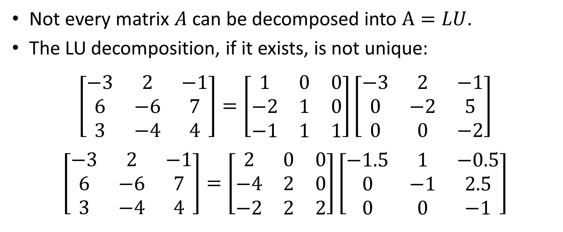
Concluding remarks
Not every matrix $A$ can be decomposed into $A=LU$.
The LU decomposition, if it exists, is not unique:
$$\left[\begin{matrix}−3 & 2 & −1 \\ 6 & −6 & 7 \\ 3 & −4 & 4\end{matrix}\right]=\left[\begin{matrix}1 & 0 & 0 \\ −2 & 1 & 0 \\ −1 & 1 & 1\end{matrix}\right]\left[\begin{matrix}−3 & 2 & −1 \\ 0 & −2 & 5 \\ 0 & 0 & −2\end{matrix}\right]$$
$$\left[\begin{matrix}−3 & 2 & −1 \\ 6 & −6 & 7 \\ 3 & −4 & 4\end{matrix}\right]=\left[\begin{matrix}2 & 0 & 0 \\ −4 & 2 & 0 \\ −2 & 2 & 2\end{matrix}\right]\left[\begin{matrix}−1.5 & 1 & −0.5 \\ 0 & −1 & 2.5 \\ 0 & 0 & −1\end{matrix}\right]$$
Notes:
Not every matrix A can be decomposed into LU.
If the Gauss elimination algorithm fails then no LU decomposition exist.
The LU decomposition is not unique.
Consider the LU decomposition displayed.
If we want we can multiply by 2 the L matrix and divide by 2 the U matrix.
We still have A decomposed into a lower and upper diagonal matrix, but with different matrices L and U.
This shows that the LU decomposition is not unique.

Slide 17
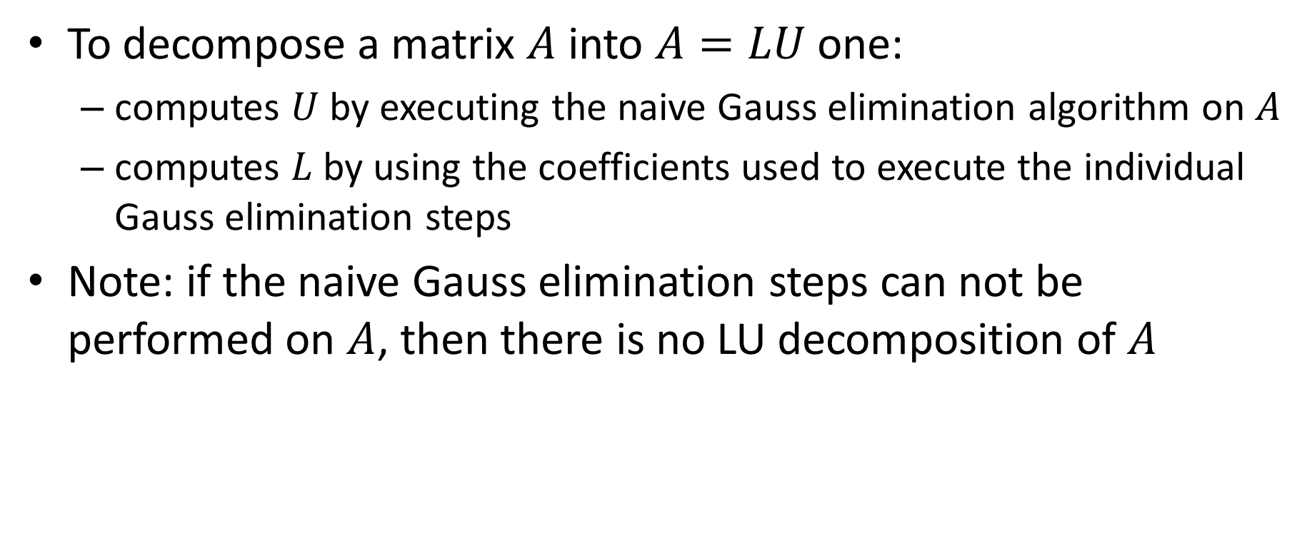
Summary
To decompose a matrix $A$ into $A=LU$ one:
computes $U$ by executing the naive Gauss elimination algorithm on $A$
computes $L$ by using the coefficients used to execute the individual Gauss elimination steps
Note: if the naive Gauss elimination steps can not be performed on $A$, then there is no LU decomposition of $A$
Notes:
Let us summarize the key findings
To decompose a matrix $A$ into $A=LU$ one:
computes $U$ by executing the naive Gauss elimination algorithm on $A$
computes $L$ by using the coefficients used to execute the individual Gauss elimination steps
Note that if the naive Gauss elimination steps can not be performed on $A$, then there is no LU decomposition of $A$

